Slide 1

LECTURE 10
Resource Allocation and
Resource Smoothing

Slide 2
The Three Categories Of Resources
LABOR
Salaried staff: These individuals include the project manager, superintendent, project engineer, secretary, and any other person who is tied to the project.
Hourly workers: These individuals are hired to perform a specific task or activity. Examples include carpenters, masons, ironworkers, electricians, foremen, and so forth.

Slide 3
The Three Categories Of Resources
Equipment and Materials
Construction equipment and materials: This type of equipment and materials is used for the construction process but is not permanently installed in the project. – Examples of construction equipment are bulldozers, backhoes,
cranes.
– Examples of construction materials are formwork materials and scaffolding.

Slide 4
The Three Categories Of Resources
Equipment and Materials
Installed equipment and materials: This type of equipment and materials stays permanently in the project after completion.
  Examples of installed equipment emergency generators (in hospitals, industrial projects)
  Examples of installed materials are concrete, rebar, brick, mortar, insulation, framing wood.

Slide 5
What Is Resource Allocation?
To ASSIGN THE REQUIRED RESOURCES TO EACH
ACTIVITY, in the required amount and timing.

Slide 6
What Is Resource Smoothing?
To minimizing the fluctuations in day-to-day resource use throughout the project.
It attempts to make the daily use of a certain resource as uniform as possible.

Slide 7
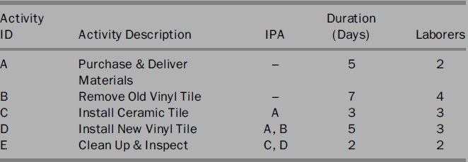
Example 2
A subcontractor needs to install flooring in two areas:
Area 1: This area has old vinyl tile that must be removed and replaced with new
vinyl tile.
Area 2: This area has a concrete slab that needs to be topped with ceramic tile. This simple project is broken into the activities shown in the following table,
*Immediately Preceding Activity.

Slide 8
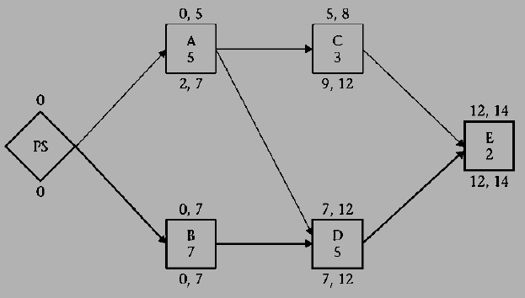
Example 2
Steps,
Draw the precedence network and perform the CPM calculations.
Allocate the required resources, then level them so that the subcontractor does not use more than six laborers at any time.
Find ways to improve the labor usage profile.
For the sake of simplicity, assume that any laborer can perform any task.
(PS: project start)

Slide 9
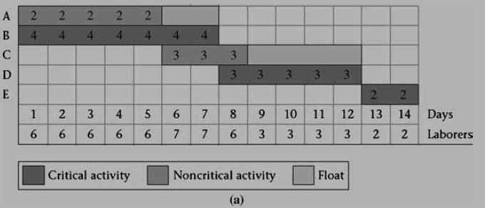
Example 2

Slide 10
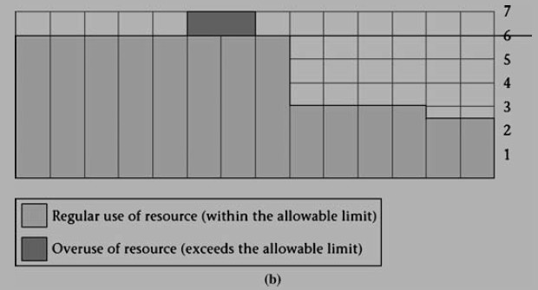
Example 2
note that on days 6 and 7, the subcontractor needs SEVEN
LABORERS, one over the limit.

Slide 11
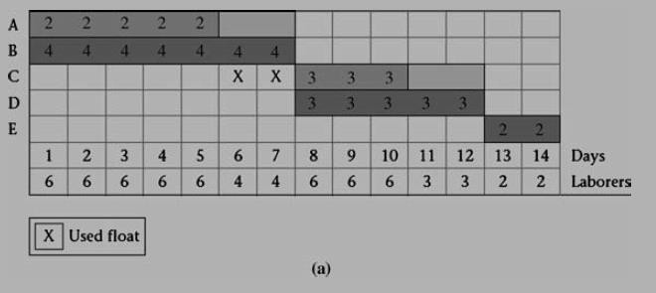
Example 2
The Contractor decides to use 2 DAYS OF THE FLOAT for activity C

Slide 12
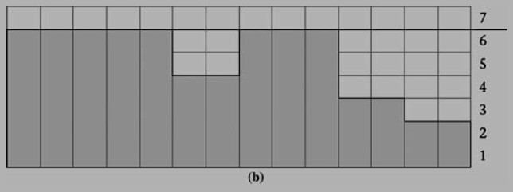
Example 2

Slide 13
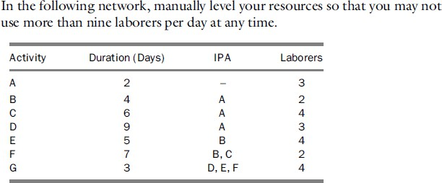
Exercise

